Slide 1
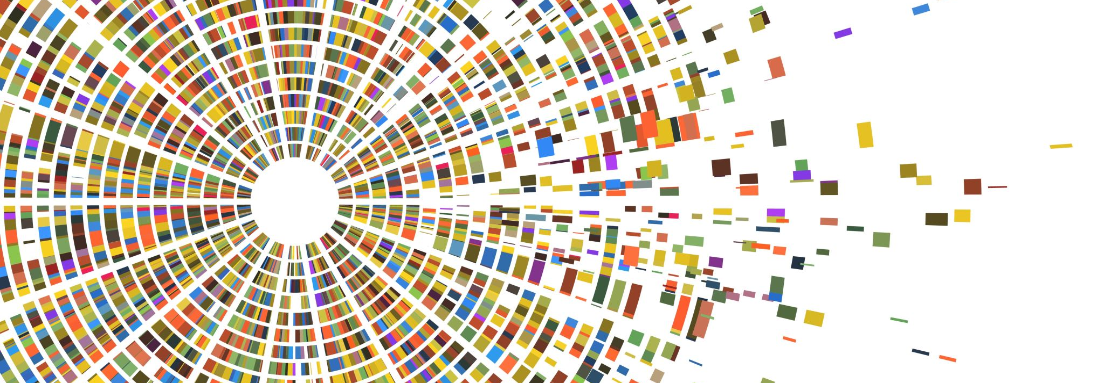
LOPERAMIDE
DEEKSHITHA ANNREDDY
11709141
DRUG

Slide 2
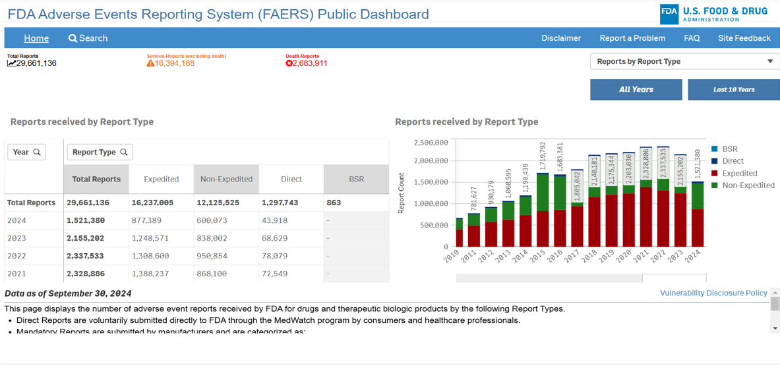
website https://fis.fda.gov/sense/app/95239e26-e0be-42d9-a960-9a5f7f1c25ee/sheet/7a47a261-d58b-4203-a8aa-6d3021737452/state/analysis

Slide 3
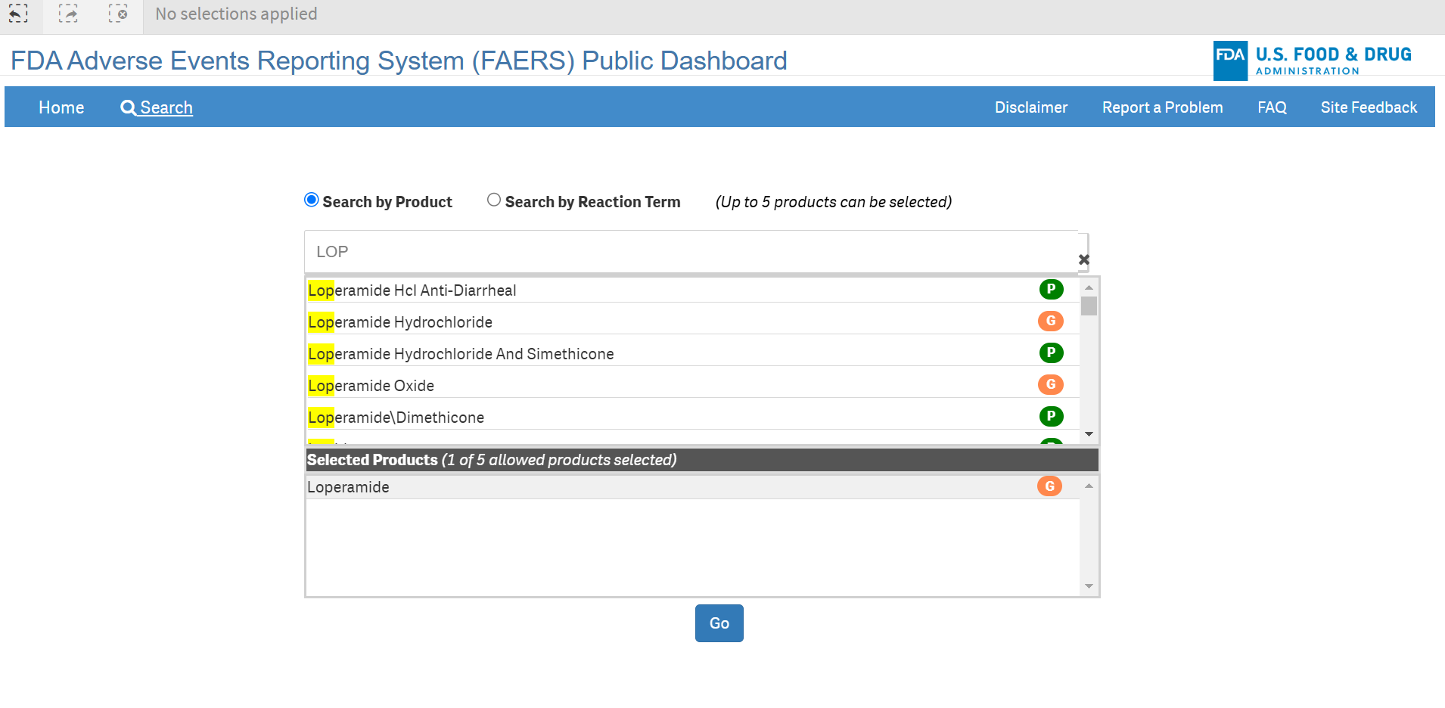
Now, select a specific drug in the search bar. Here, I have selected “Loperamide” drug for the data analysis.

Slide 4
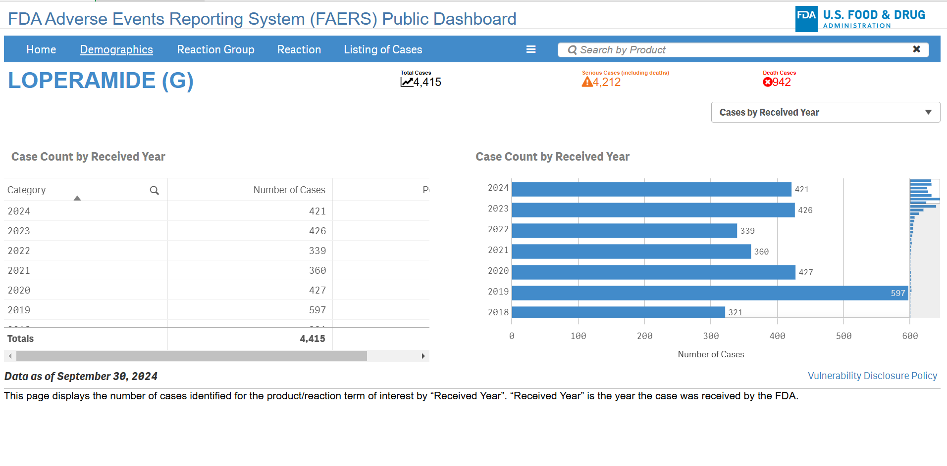
This shows the analysis of the Loperamide drug.

Slide 5
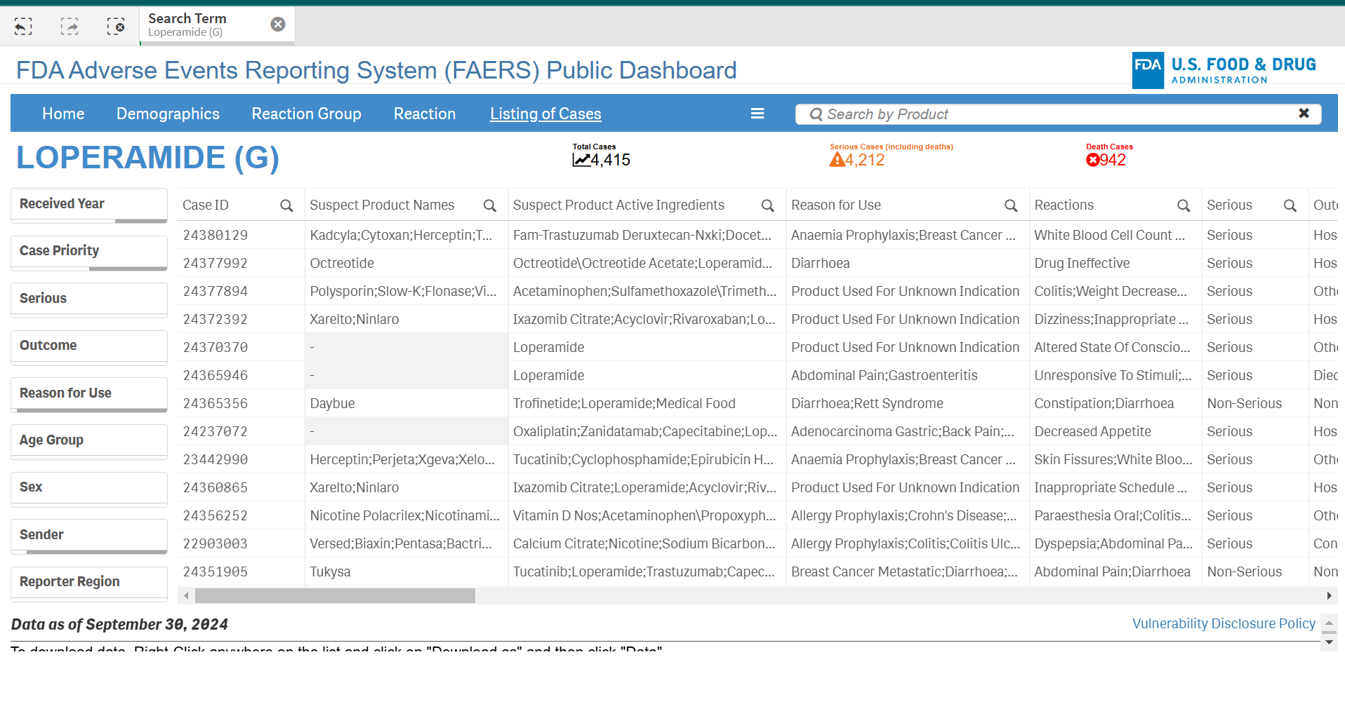
By clicking on listing of cases we can able to access the relevant data.

Slide 6
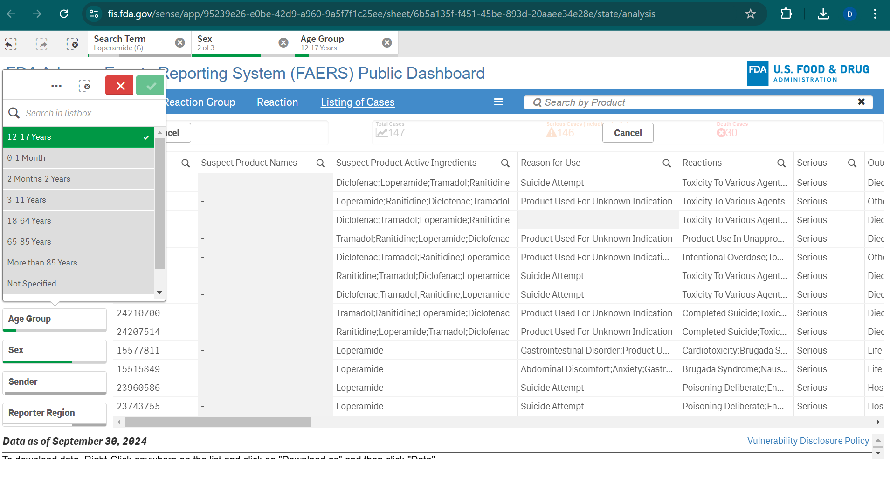
Through this we can access parameters of the data such as age, sex, Sender.

Slide 7
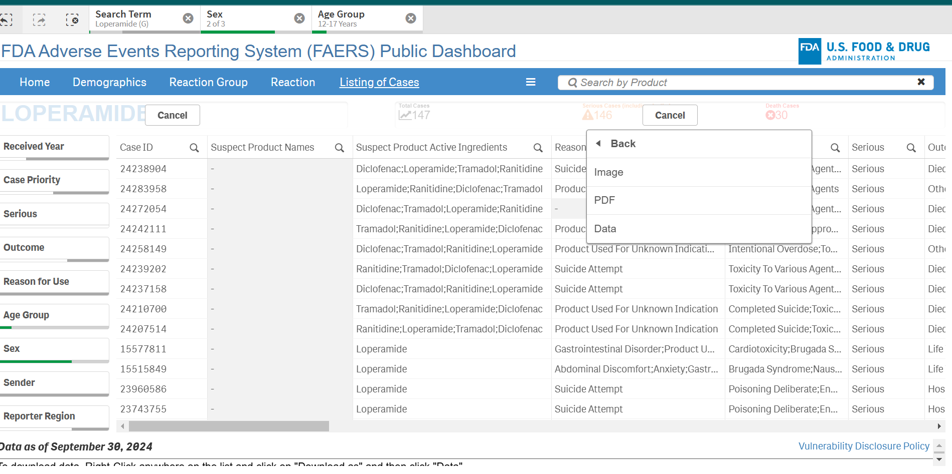
Now download the data.

Slide 8
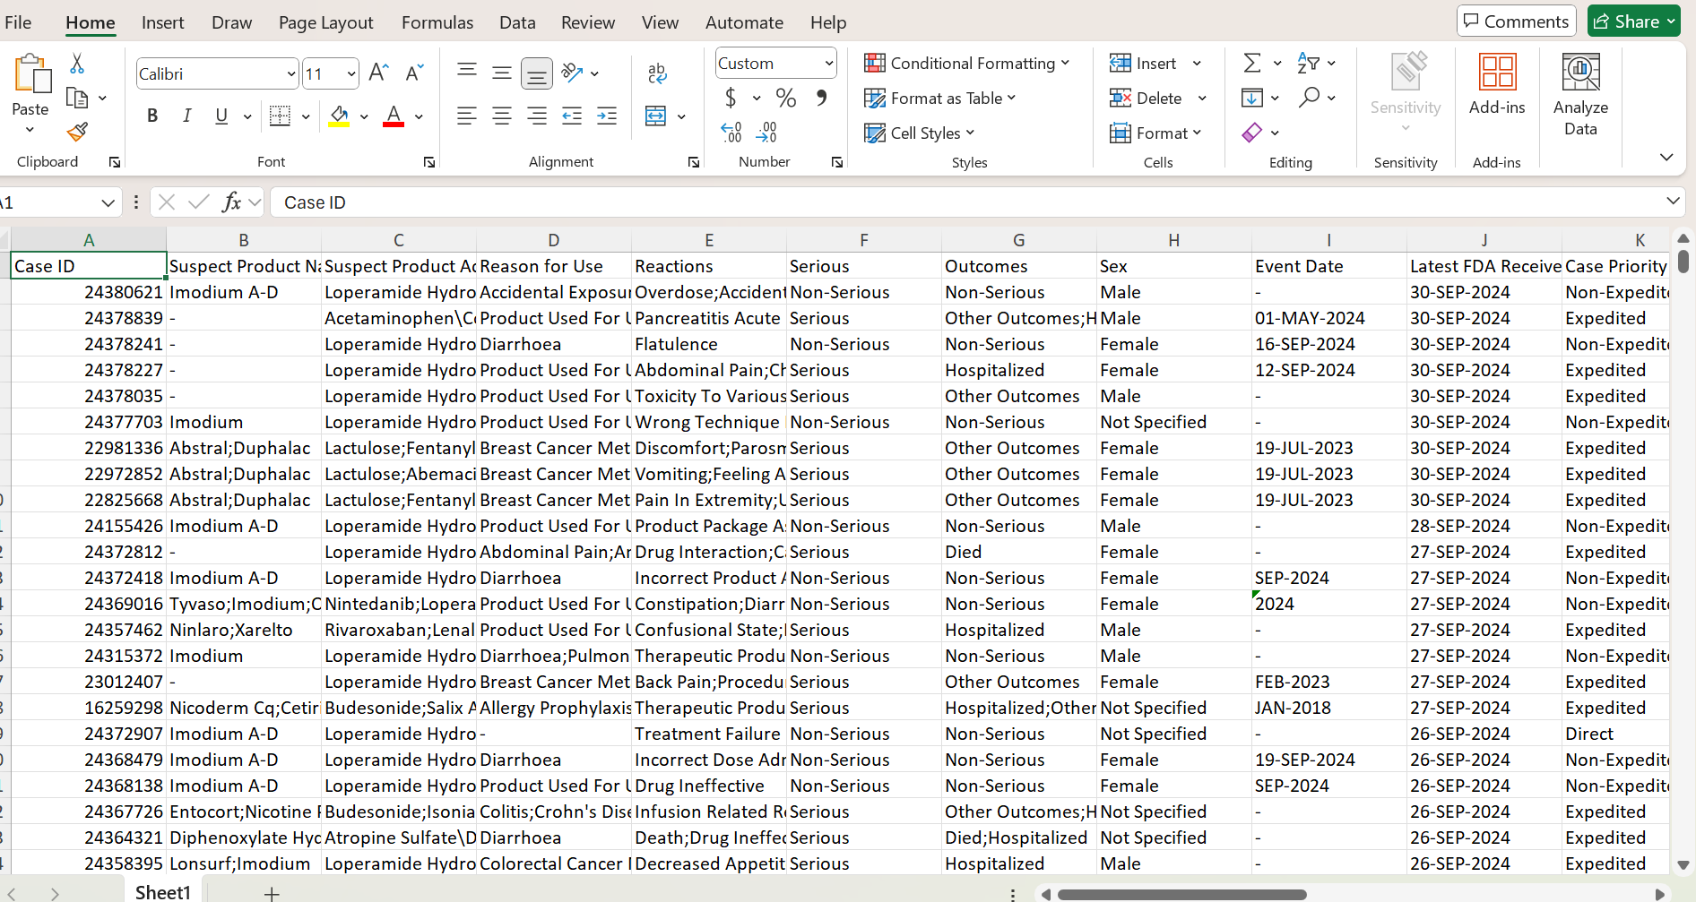
The below is the data file we have downloaded.

Slide 9
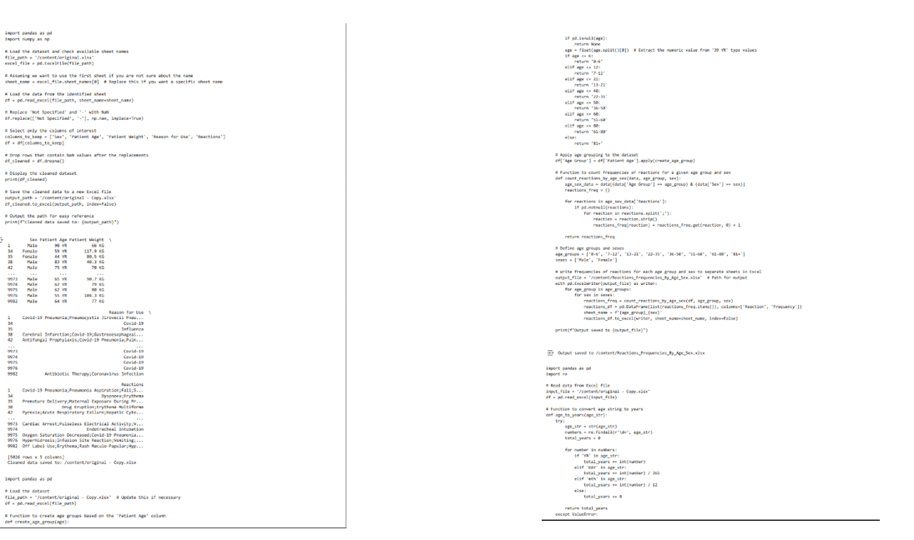
Now, run the below code in google colab to clean the data.

Slide 10
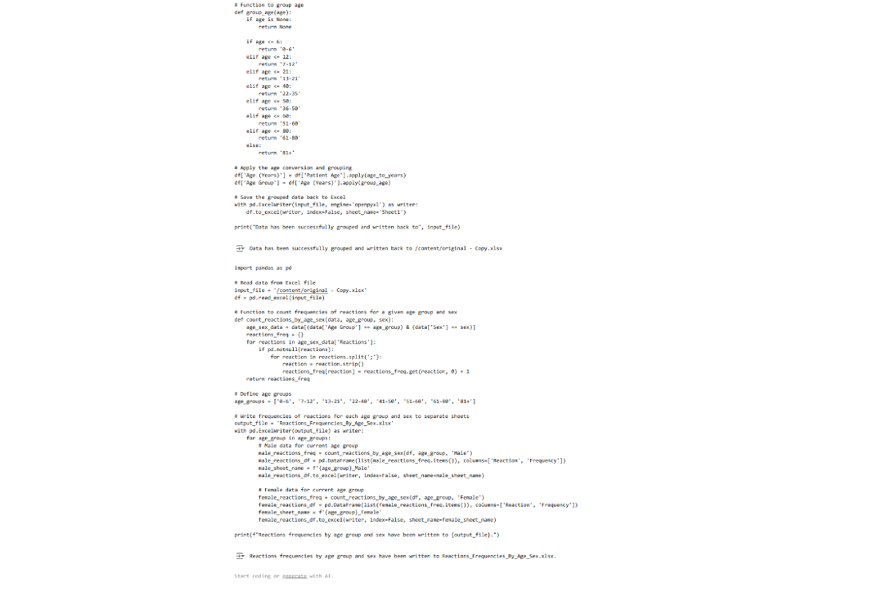

Slide 11
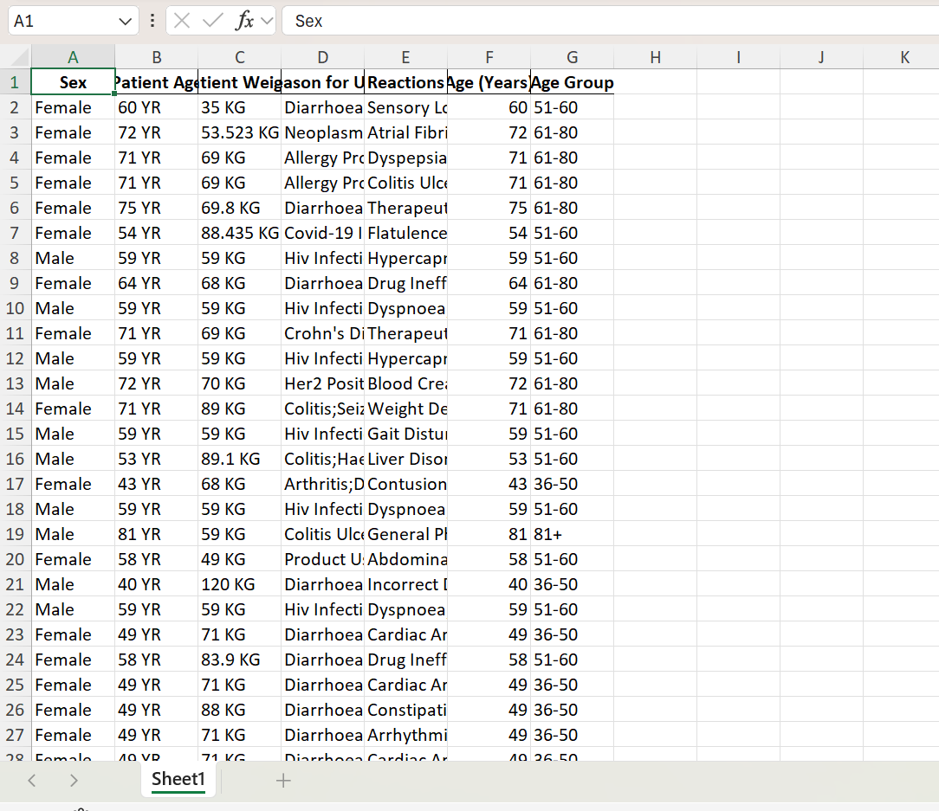
The data is the data from cleaned dataset that is output of the first code then this data is used as input for next code.

Slide 12
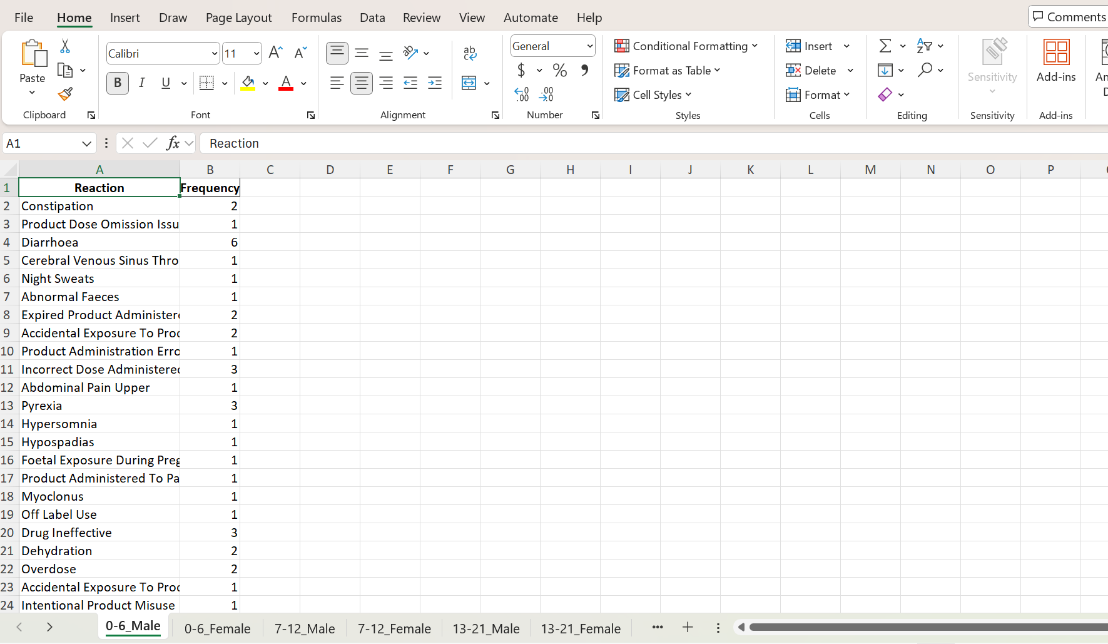
From the second code we get the reactions file in this dataset we can see a new parameter called frequency and data is shown below;

Slide 13
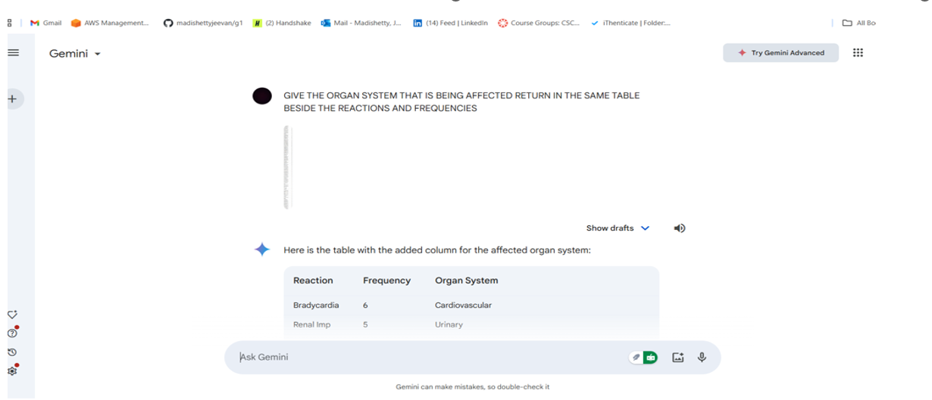
Now, paste this command in gemini ““give the organ system that the reaction is effecting give it in the same table beside the frequency” .

Slide 14
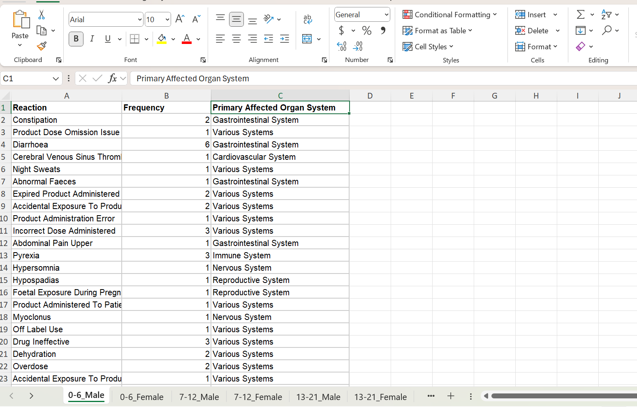
The below is the reactions file we get after entering that command in gemini.

Slide 15
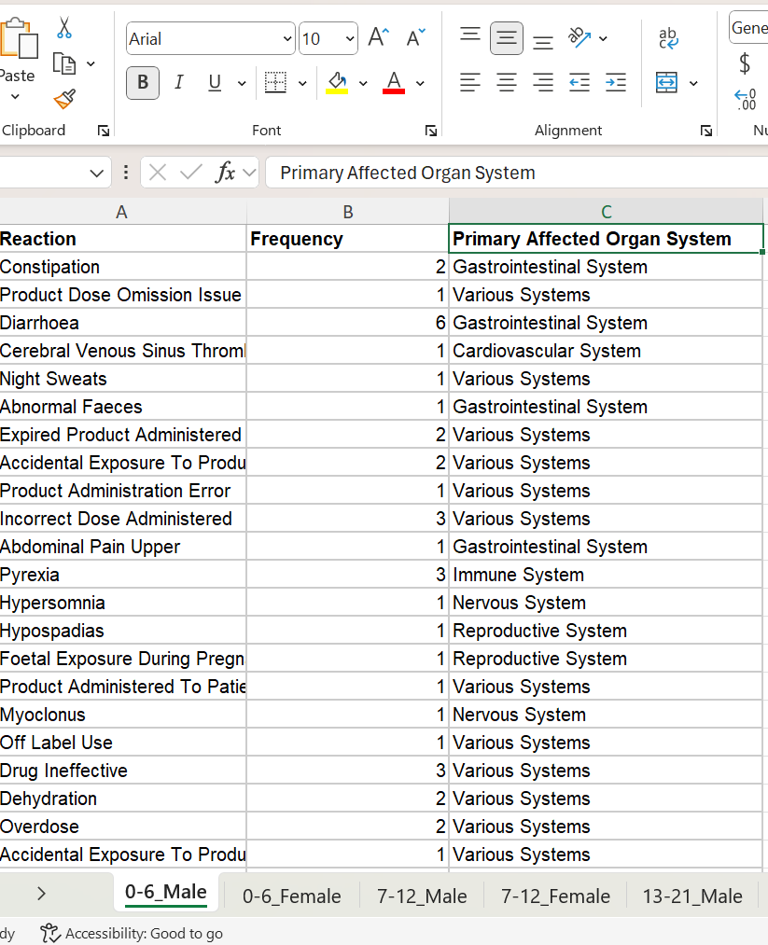
Sort each organ system with filters, then find the total frequency count for each organ system. These slides are about the piroxicam drug. They are about girls and women ages 22 to 35 and the circulatory system

Slide 16
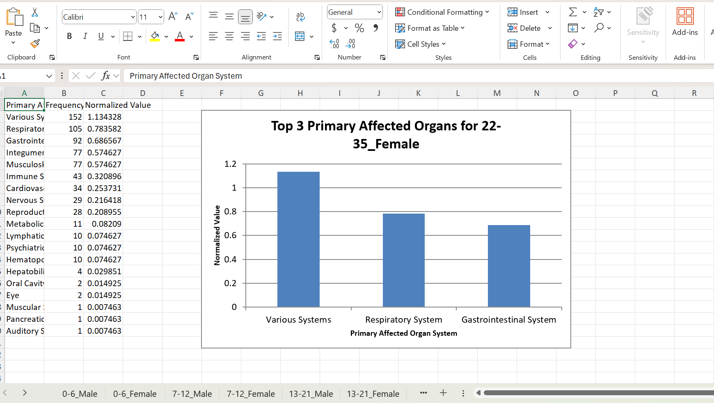
By this dataset we can see a graph of top 3 affected organs of age group 22-35 female and male.

Slide 17
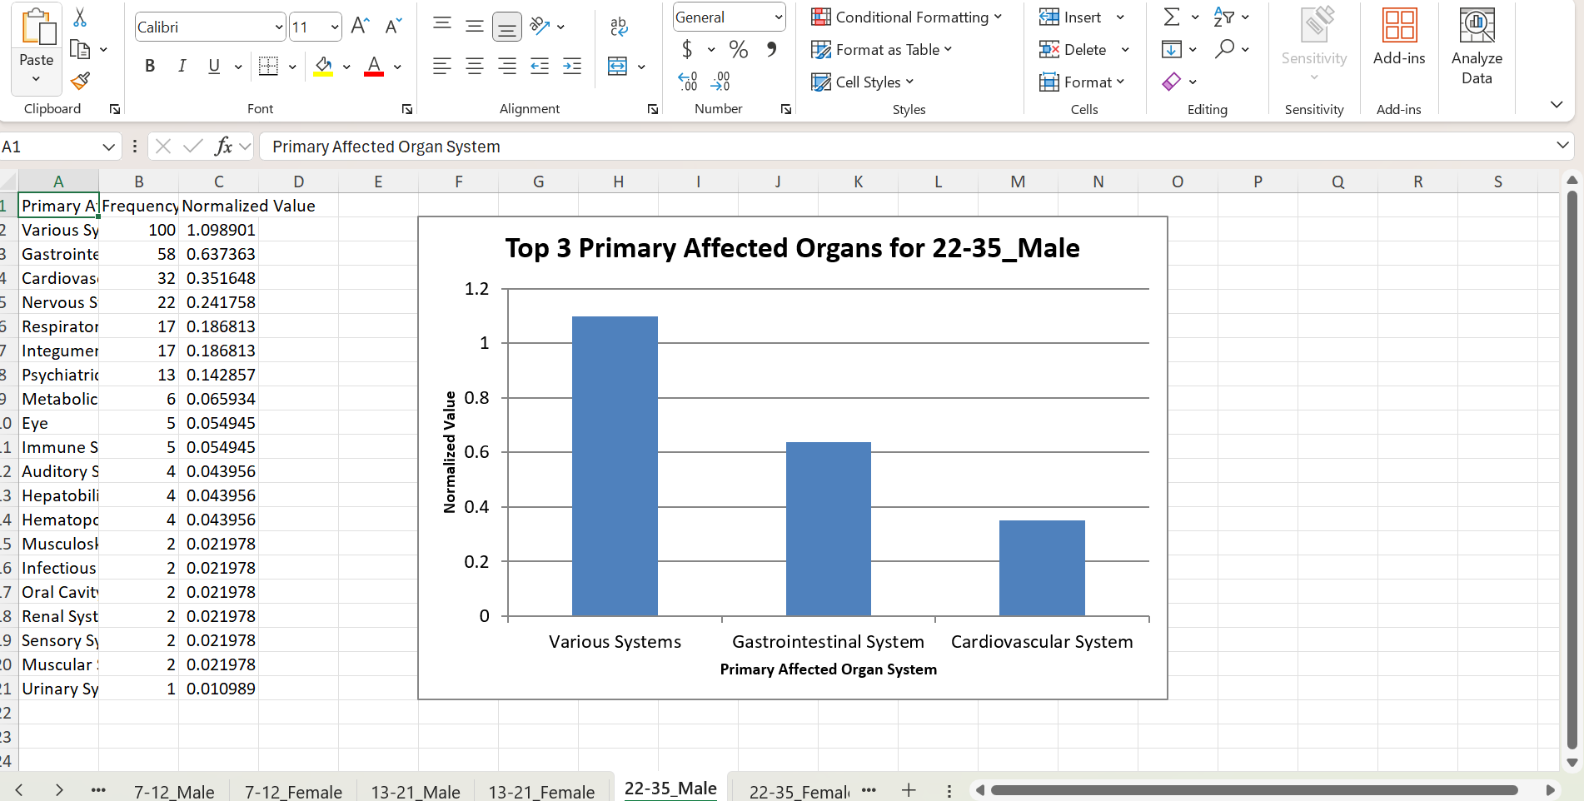

Slide 18
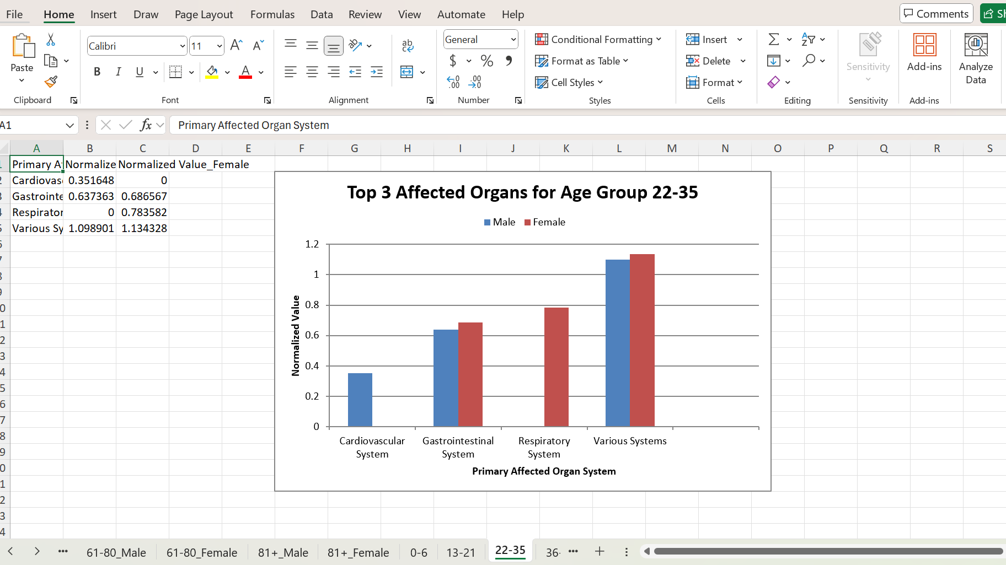
Finally, below graph shows the normalized values for both male and female as shown below.

Slide 19

THANK YOU

